Slide 1
Week 2
The Concept of the Commons

Slide 2
Session Outline
What are “the Commons”?
Hardin’s Theory of the Commons
Ostrom’s Theory of the Commons
Summary
Vocabulary Review
Required Materials
Supplemental Materials
Assignments
Notes:
Image Source: http://www.motherearthnews.com/~/media/Images/MEN/Editorial/Articles/Magazine%20Articles/1979/05-01/Dr%20Garrett%20Hardin%20Human%20Overpopulation%20Survival%20and%20Morality/057%20dr%20garrett%20hardin%20-%20cover.jpg

Slide 3
Learning Objectives
By the end of this session, you will be able to:
Understand the concept of ‘the commons,’ including where the concept began and the two major theories of the commons
Identify examples of both Hardin’s theory and Ostrom’s theory of the commons
Apply the concept of the commons to business

Slide 4
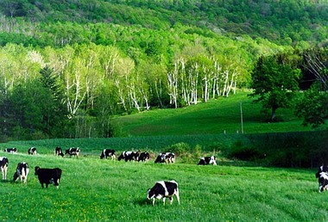

What are the commons?
The commons is a general term for shared resources in which each stakeholder has an equal interest (Digital Library of the Commons, 2009)
Key: Access + Shared
[Trayger, Nat. The Tragedy of the Commons. [Image]. Retrieved from: http://nyencore.com/2012/07/the-tragedy-of-the-commons/]
[Dreamatico. Dream Interpretation. [Image]. Retrieved from: http://dreamatico.com/ocean.html]

Slide 5
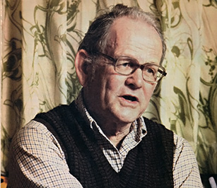

Introduction
Garrett Hardin, ecologist, wrote “Tragedy of the Commons”
Elinor Ostrom, political economist/Nobel Laureate, discussed Common Pool Resources and Social Ecological Systems
[Motherartnews.[Image]. Retrieved from: http://www.motherearthnews.com/~/media/Images/MEN/Editorial/Articles/Magazine%20Articles/1979/05-01/Dr%20Garrett%20Hardin%20Human%20Overpopulation%20Survival%20and%20Morality/057%20dr%20garrett%20hardin%20-%20cover.jpg]
[Vitablity Magazine.[Image]. Retrieved from: http://vitalitymagazine.com/images/uploads/Dec10Jan11_Elinor.jpg]
Notes:
Image Source: http://vitalitymagazine.com/images/uploads/Dec10Jan11_Elinor.jpg

Slide 6
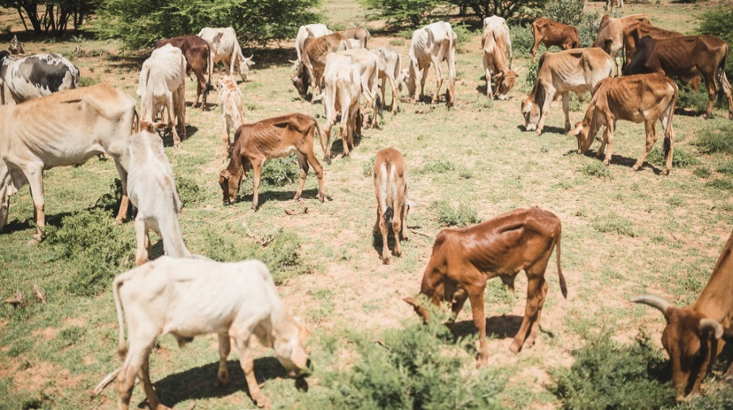
Origins
Where did it start?
William Foster Lloyd 1833, “The commons”
Hardin (1968) “Tragedy of the Commons”
Overpopulation
Example: Overgrazing of common land
[Baadiye. [Image]. Retrieved from: http://baadiye.com/wp-content/uploads/2015/07/XOOLAHASL.jpg]
Notes:
Image Source: http://baadiye.com/wp-content/uploads/2015/07/XOOLAHASL.jpg

Slide 7

Solution (Hardin)
Privatization
Government Regulation
Quota Limits
[Public Works. [Image]. Retrieved from: http://www.publicworks.org/wp-content/uploads/2014/12/red-tape-govt-300x300.jpg]
Notes:
Image Source:

Slide 8
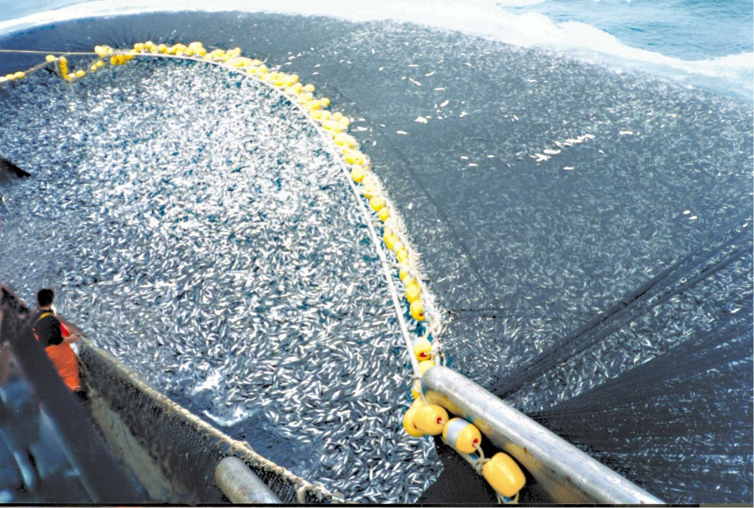
Example
-Overfishing our Oceans
-Industrial Fishing
-Ex: Chilean seabass, long time to recover
-What rules should be established to ensure sustainable fishing?
[Wikimedia. [Image]. Retrieved from: https://upload.wikimedia.org/wikipedia/commons/0/00/Chilean_purse_seine.jpg]
Notes:
Image Source: https://upload.wikimedia.org/wikipedia/commons/0/00/Chilean_purse_seine.jpg

Slide 9
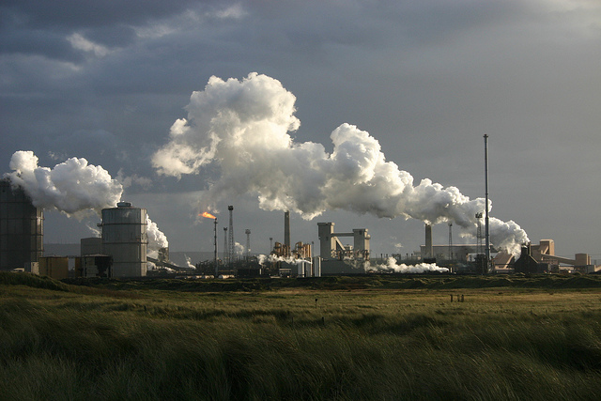
Example Cont.
-Pollution (GHG) in the atmosphere
-Ex: Generic industrial facility
-Who is responsible for regulating the air?
[Conserve Energy Future. [Image]. Retrieved from: http://www.conserve-energy-future.com/wp-content/uploads/2013/06/Pollution_From_Industries.jpg]
Notes:
Image Source:

Slide 10

Business Application
-Scarcity: human wants will always exceed the resources available to fulfill those wants
-Ex: Water
[Pearl Waterless International. [Image]. Retrieved from: http://pearlwaterlessinternational.com/wp-content/uploads/2015/05/pearlcarcare.jpg]
Notes:
Image Source:

Slide 11
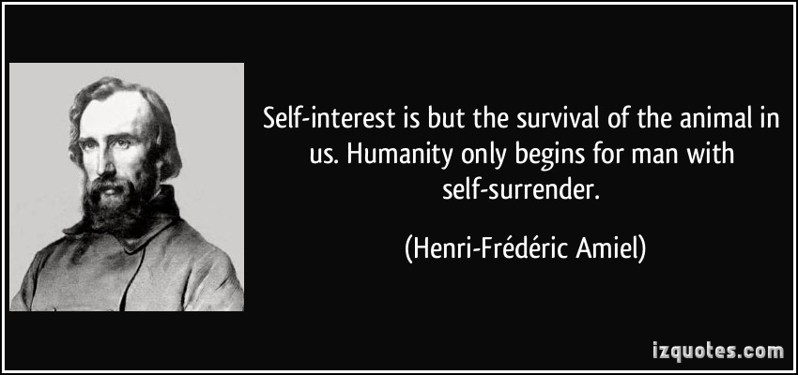
Business Application Cont.
-Self-interest: one's personal interest or advantage, especially when pursued without regard for others.
-Should we regard others?
[izquotes. [Image]. Retrieved from: http://izquotes.com/quotes-pictures/quote-self-interest-is-but-the-survival-of-the-animal-in-us-humanity-only-begins-for-man-with-henri-frederic-amiel-4409.jpg]
Notes:
Image Source:

Slide 12
A different lens
Challenging “Tragedy of the Commons”
Elinor Ostrom “Social Ecological Systems” (SES)/ Common Pool Resources (CPRs)
Strong assumptions
Large Groups
No Communication
No rights to the resources exist
Collective Approach (working together)

Slide 13
Regulation Challenges
Central regulation has frequently accelerated resource deterioration with complications of corruption and inefficiency.
There have been documented cases of overharvesting of forests after national governments declared owners of forested land
Problems have occurred with inshore fisheries when national agencies presumed they had exclusive jurisdiction over all coastal waters

Slide 14
CPRs
Common Pool Resources (CPRs) include natural and human-constructed resources in which
exclusion of beneficiaries through physical and institutional means is especially costly
exploitation by one user reduces resource availability for others (Ostrom et al., 1994)
Solving CPR problems involves two distinct elements (need both):
restricting access
creating incentives for users to invest in the resource instead of overexploiting it.

Slide 15
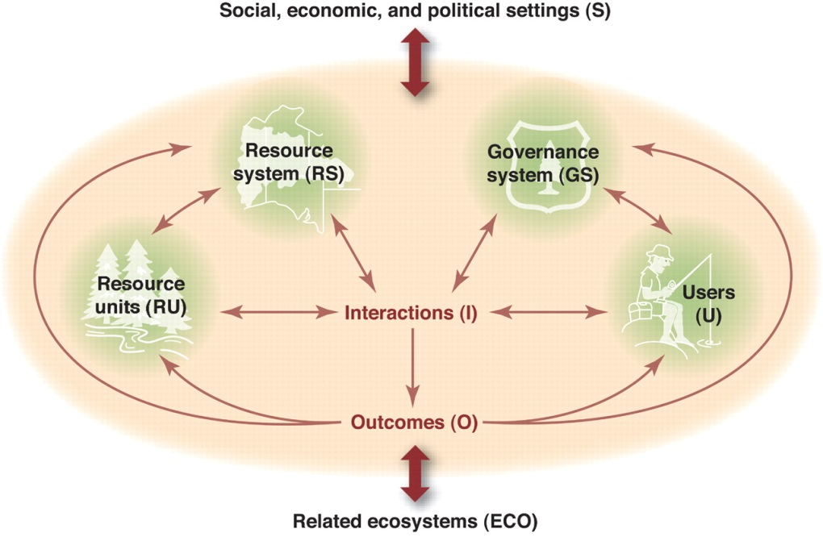
SES
All humanly used resources are embedded in complex, social-ecological systems (SES)
SESs are composed of multiple subsystems and internal variables within these subsystems
[Ostrom, E. (2009). A general framework for analyzing sustainability of social-ecological systems. Science, 325(5939), 419-422.]
Notes:
Image Source:

Slide 16
Solution (Ostrom)
8 Principles for Managing a Commons
1. Define clear group boundaries.
2. Match rules governing use of common goods to local needs and conditions.
3. Ensure that those affected by the rules can participate in modifying the rules.
4. Make sure the rule-making rights of community members are respected by outside authorities.
5. Develop a system, carried out by community members for monitoring members’ behavior.
6. Use graduated sanctions for rule violators.
7. Provide accessible, low-cost means for dispute resolution.
8. Build responsibility for governing the common resource in nested tiers from the lowest level up to the entire interconnected system.

Slide 17
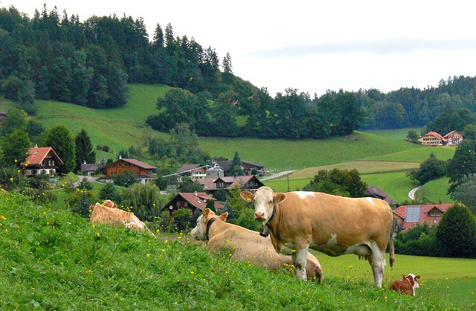
Example
Swiss village, farmers tend private plots for crops, but share communal meadow to graze their cows
“wintering rules,” which prohibit sending more cows to the grazing lands than one can feed during the winter
[Vivify Change Catalyst. [Image]. Retrieved from: https://vivifychangecatalyst.files.wordpress.com/2015/07/swiss-cows.jpg]
Notes:
Image Source:

Slide 18
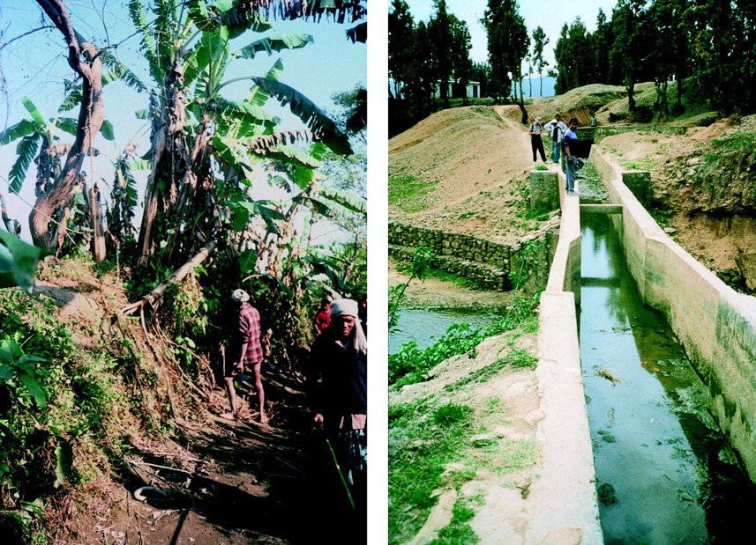
Example Cont.
The government-owned Chiregad irrigation system (Nepal) was constructed to replace five farmer-owned irrigation systems that operated well by their own.
Results showed that not only do the farmers invest heavily in the maintenance of the farmer-owned system, they have devised effective rules related to access and the allocation of benefits and costs. They achieve higher productivity than most government-owned systems with modern infrastructure” (Ostrom et al., 1999)
[Ostrom, E., Burger, J., Field, C. B., Norgaard, R. B., & Policansky, D. (1999). Revisiting the commons: local lessons, global challenges. science,284(5412), 278-282.]

Slide 19

Example Cont.
-Technological Commons
-Users can edit & update content
-Access to information?
[Wikimedia. [Image]. Retrieved from: https://upload.wikimedia.org/wikipedia/commons/5/53/Wikipedia-logo-en-big.png]
Notes:
Image Source:

Slide 20
Summary
Understand concept of The Commons from the perspectives of:
Hardin
Ostrom
Identify examples
Application to business

Slide 21
Vocabulary Review
The Commons: A general term for shared resources in which each stakeholder has an equal interest
Hardin: Ecologist who wrote “Tragedy of the Commons”
Ostrom: Political economist and Nobel Laureate who discussed Common Pool Resources and Social Ecological Systems
Scarcity: The idea that human wants will always exceed the resources available to fulfill those wants
Self-interest: One's personal interest or advantage, especially when pursued without regard for others.
SES: The idea that all humanly used resources are embedded in complex, social-ecological systems (SES). SESs are composed of multiple subsystems and internal variables within these subsystems.
CPR: Common Pool Resources. These include natural and human-constructed resources in which (1) exclusion of beneficiaries through physical and institutional means is especially costly; and (2) exploitation by one user reduces resource availability for others .

Slide 22
Required Materials
Videos
Ending the Tragedy of the Commons, Elinor Ostrom, 23 Apr 2012.
Tragedy of the Commons: The Problem with Open Access, This Place, 9 Jun 2015.
Readings
In Dramatic Statement, Eureopan Leaders Call for ‘Immediate’ Open Access to All Scientific Papers by 2020, Martin Enserink, Science, 27 May 2016.
The Commons: A Historical Concept Of Property Rights, Hartmut Zuckert, Counter Solutions, 19 Aug. 2016.

Slide 23
Supplemental References
Readings
The Tragedy of the Commons, Garett Hardin, Science, 13 Dec 1968.
Tragedy of the Commons, Elinor Ostrom, The New Palgrave Dictionary of Economics, 2nd edn., 23 Jun 2010.
A general framework for analyzing sustainability of social-ecological systems, Elinor Ostrom, Science, 24 Jul 2009.
The tragedy of the commons: twenty-two years later. David Feeny et al., Human Ecology, Mar 1990.

Slide 24
Assignments
1. Based on the required reading and your viewing of this week’s video and slides, please post your answer to the following question in the discussion forum.
In your own words, what is “the commons”?
Be sure to include what Hardin and Ostrom claim about “the commons.” Your response should be roughly 200 words in length. Please read at least two of your fellow students’ responses as well and provide comments on them (refer to peer review guide).
Optional Assignment
2. Register as an individual to play the Fishbanks: A Renewable Resource Management Simulation by the MIT Sloan School of Management. Be sure to read the instructions before starting.

Slide 25
References
Big Think. (2012, April 23). Ending The Tragedy of The Commons [Video file]. Retrieved from https://www.youtube.com/watch?v=Qr5Q3VvpI7w
Dietz, T., Ostrom, E., & Stern, P. C. (2003). The struggle to govern the commons. Science, 302(5652), 1907-1912.
Feeny, D., Berkes, F., McCay, B. J., & Acheson, J. M. (1990). The tragedy of the commons: twenty-two years later. Human Ecology, 18(1), 1-19.
Hardin, G. (1968). The Tragedy of the Commons. Science, 162(3859), 1243-1248.
MITSloan Management (2016). Fishbanks. MIT. Retrieved from https://forio.com/simulate/mit/fishbanks/simulation/login.html
Ostrom, E. (2008). Tragedy of the Commons. The New Palgrave Dictionary of Economics, 3573-3576.
Ostrom, E. (2009). A general framework for analyzing sustainability of social-ecological systems. Science, 325(5939), 419-422.
Ostrom, E. (2009). A general framework for analyzing sustainability of social-ecological systems. Science, 325(5939), 419-422.
Ostrom, E., Burger, J., Field, C. B., Norgaard, R. B., & Policansky, D. (1999). Revisiting the commons: local lessons, global challenges. science,284(5412), 278-282.
Ostrom, E., Gardner, R., & Walker, J. (1994). Rules, games, and common-pool resources. University of Michigan Press.
This Place. (2015, June 9). Tragedy of the Commons, The Problem with Open Access [Video file]. Retrieved from https://www.youtube.com/watch?v=WYA1y405JW0
Vincent and Elinor Ostrom Workshop in Political Theory and Policy Analysis (2009). Digital Library of the Commons. Retrieved from Indian University Website: https://dlc.dlib.indiana.edu/dlc/

